Slide 1

Driving Walmart’s Growth: Data-Backed Marketing Insights
Analyzing Store Performance, Market Trends, and Customer Behavior (2010–2012)
Dataset Source: https://www.kaggle.com/datasets/mikhail1681/walmart-sales
Jermaine Sangiwa

Slide 2

Introduction
Key Objectives
🔍 Uncover top-performing stores and growth opportunities.
📈 Quantify the impact of holidays, fuel prices, and economic factors on sales.
⚠️ Identify high-risk stores needing urgent intervention.
🎯 Recommend actionable strategies to optimize marketing spend.

Slide 3
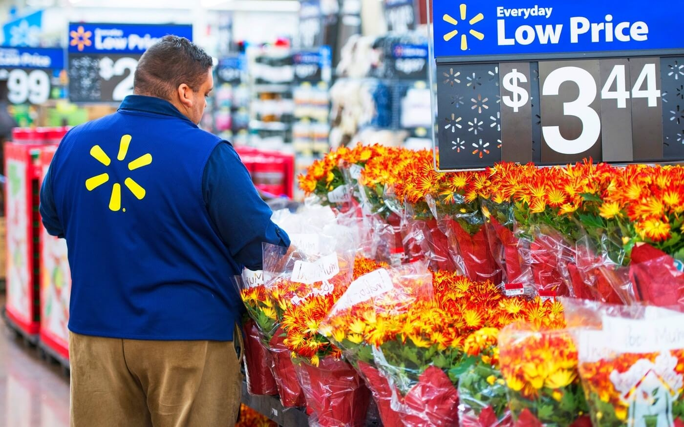
About Dataset
The analysis will focus on the sales data of one of the largest retailers in the world to support the marketing team in identifying revenue-influencing factors. The analyst will investigate whether variables such as air temperature and fuel costs affect the company's success, alongside the purchasing power index and seasonal discounts. Additionally, the analyst will explore how machine learning can be leveraged to minimize costs and enhance economic impact.
The analysis will utilize the following columns from the data:
Store: Store number
Date: Sales week start date
Weekly_Sales: Sales figures
Holiday_Flag: Indicator of holiday presence or absence
Temperature: Air temperature in the region
Fuel_Price: Fuel costs in the region
CPI: Consumer price index
Unemployment: Unemployment rate

Slide 4
Table
store_no | Date | Weekly_Sales | Holiday_Flag | Temperature | Fuel_Price | CPI | Unemployment
1 | 05/02/2010 | $ 1,643,690.90 | 0 | 42.3 | $ 2.57 | 211.10 | 8.11
1 | 12/02/2010 | $ 1,641,957.44 | 1 | 38.5 | $ 2.55 | 211.24 | 8.11
1 | 19/02/2010 | $ 1,611,968.17 | 0 | 39.9 | $ 2.51 | 211.29 | 8.11
1 | 26/02/2010 | $ 1,409,727.59 | 0 | 46.6 | $ 2.56 | 211.32 | 8.11
1 | 05/03/2010 | $ 1,554,806.68 | 0 | 46.5 | $ 2.63 | 211.35 | 8.11
1 | 12/03/2010 | $ 1,439,541.59 | 0 | 57.8 | $ 2.67 | 211.38 | 8.11
1 | 19/03/2010 | $ 1,472,515.79 | 0 | 54.6 | $ 2.72 | 211.22 | 8.11
1 | 26/03/2010 | $ 1,404,429.92 | 0 | 51.5 | $ 2.73 | 211.02 | 8.11
1 | 02/04/2010 | $ 1,594,968.28 | 0 | 62.3 | $ 2.72 | 210.82 | 7.81
1 | 09/04/2010 | $ 1,545,418.53 | 0 | 65.9 | $ 2.77 | 210.62 | 7.81
This shows the first 10 of 1000 records

Slide 5
Top 5 best and worst performing stores
Top 5 best performing stores
Stores | Average Sales
20 | $ 2,107,676.87
4 | $ 2,094,712.96
14 | $ 2,020,978.40
13 | $ 2,003,620.31
2 | $ 1,925,751.34
Store 20 is the best performing Walmart store, with an average (weekly) sales of US$2.11 Million. The average sales of the 5 most well performing stores is US$2.03 Million.
Store 33 is the worst performing Walmart store, with an average weekly sales of US$ 259.86K. The average sales of the 5 least well performing stores is US$327.97K
Top 5 worst performing stores
Stores | Average Sales
33 | $ 259,861.69
44 | $ 302,748.87
5 | $ 318,011.81
36 | $ 373,511.99
38 | $ 385,731.65

Slide 6
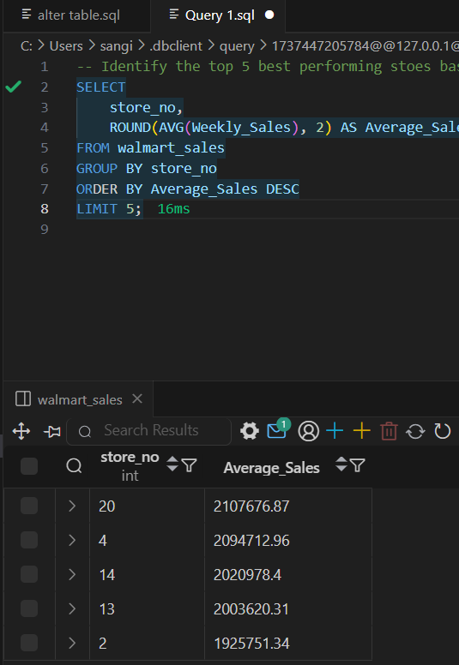
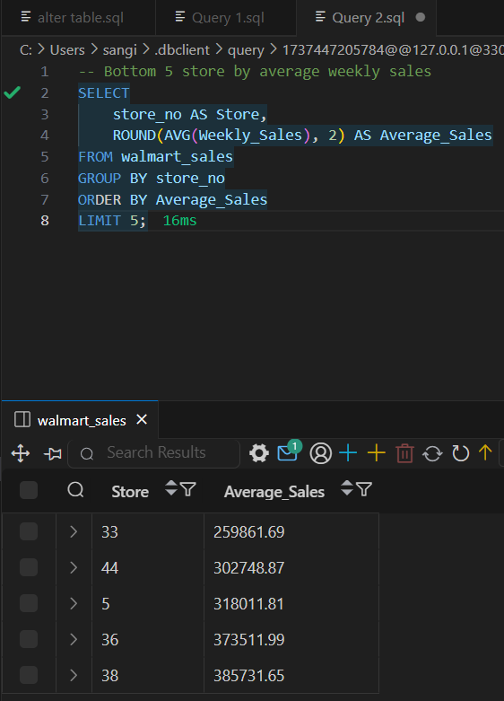
SQL Query

Slide 7
Quantify how Holidays affect Sales
This table represents how holidays affect Walmart stores’ sales, with 1 representing holiday while 0 represent not holiday.
The average sales of Walmart stores during the holidays is US$1.123 Million, while the average sales of Walmart stores not during holidays is US$1.041 Million.
This indicates Walmart generates more sales during the holiday than they do during the normal days, but by only US$ 81,631.51.
What I would recommend is that the marketing team should advertise more during the holidays and offer appealing discounts and promotions in order to attract more customers in your stores, thus increasing sales.
Holiday_Flag | Average Sales
0 | $ 1,041,256.38
1 | $ 1,122,887.89

Slide 8
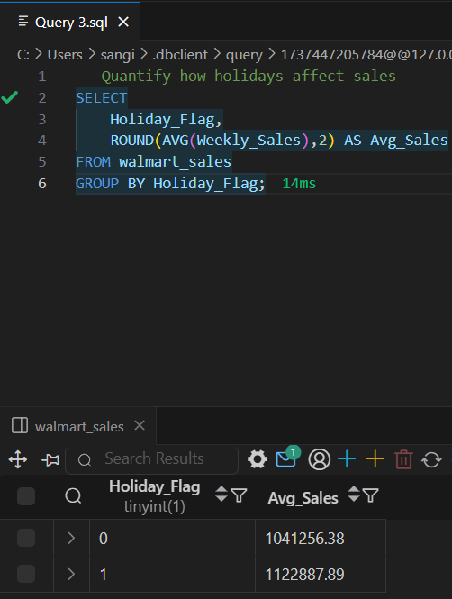
SQL Query

Slide 9
Quantify if temperature affect sales
This table represents how different temperature affect sales. There are four groups, which are: Cool, Mild, Warm, Hot.
As you can see, when temperature is “Cool”, Walmart sees the highest sales, with US$ 1.096 Million in sales.
At the same time, Walmart generates least number of sales, with US$ 796.97K in sales generated when temperature are “Hot”.
This contrast indicates that customers shop more when the temperature is cooler.
The following recommendations I can offer to boost sales at hot temperatures:
Introduces incentives such as selling more weather-appropriate products such as cold beverages and snacks, cooling accessories or summer apparel to encourage customers to shop during hot weathers.
Creating an inviting in store experience like ensuring air conditioning are working well and providing seating in a shaded or air-conditioned space or offering free samples of cold drinks or chilled snacks can attract more customers.
Adjusting your promotions and discounts can help attract more customers. Heatwave discount on cold drinks or cooling products, Buy One Get One can encourage customers to buy more or Happy Hour Deals on could drink during peak heat hours (12pm to 5pm).
Temperature group | Total Sales
Cool | $ 1,096,272.00
Mild | $ 1,047,313.00
Warm | $ 1,024,500.00
Hot | $ 796,966.00

Slide 10
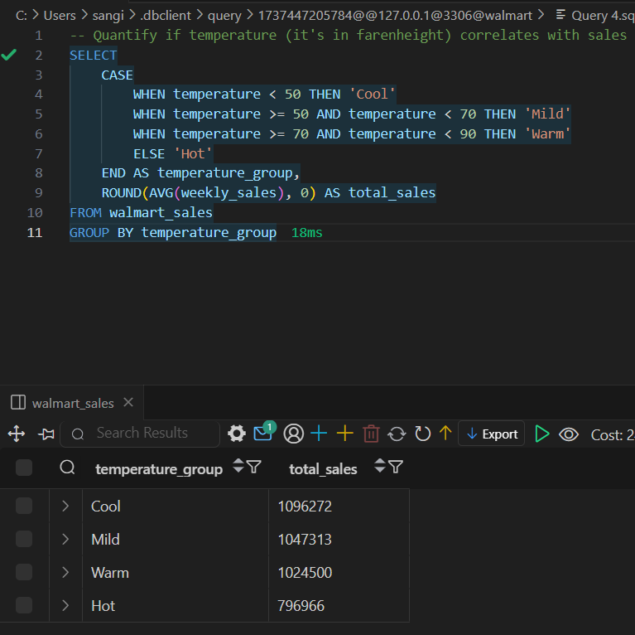
SQL Query

Slide 11
How Fuel Prices affect sales
This table represents how fuel prices affect sales. Fuel prices are categorized into four groups: Very Low, Low, Medium, High.
Average weekly sales is higher when fuel price is low, with the average sales of US$1.051 Million, while the average weekly sales is low, with US$470K, when fuel price is very low.
The reason why sales is very low when fuel price is very low could be because of:
Inflation may reduce fuel price but also reduce customer likelihood to spend.
It could be because of deflation pressure, where prices across the board start dropping. That might make people delay purchases in hopes prices will fall further—lowering sales overall.
Fuel Price Range | Avg Weekly Sales
Low | $ 1,050,749.00
Medium | $ 1,043,320.00
High | $ 1,040,264.00
Very Low | $ 470,281.00

Slide 12
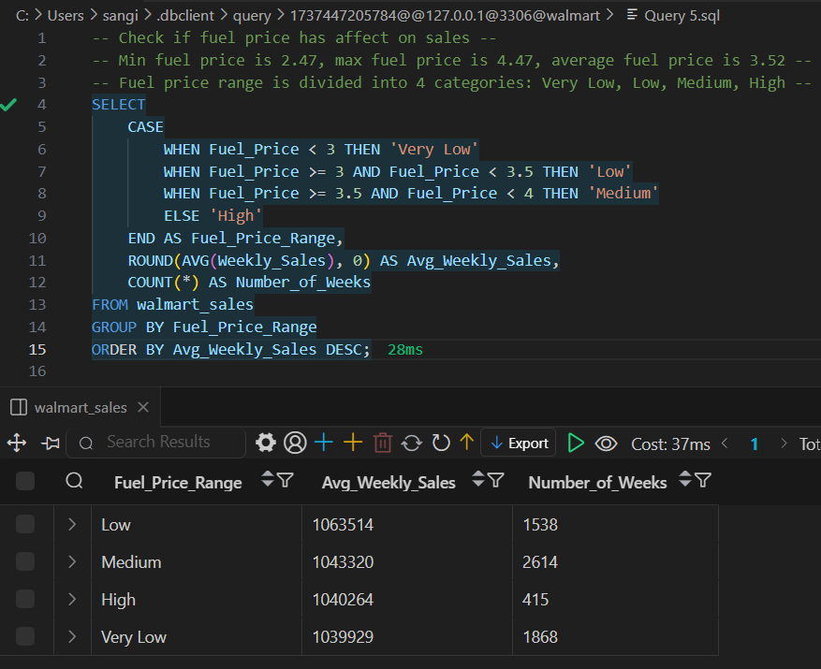
SQL Query

Slide 13
Investigate how inflation (CPI) impacts sales across stores
Stores | Average CPI | Average Sales
9 | 219.6 | $ 543,980.60
11 | 219.4 | $ 1,356,383.10
3 | 219.4 | $ 402,704.40
8 | 219.4 | $ 908,749.50
6 | 217.6 | $ 1,564,728.20
5 | 216.6 | $ 318,011.80
1 | 216 | $ 1,555,264.40
2 | 215.6 | $ 1,925,751.30
31 | 215.6 | $ 1,395,901.40
30 | 215.6 | $ 438,579.60
21 | 215.6 | $ 756,069.10
39 | 214.7 | $ 1,450,668.10
37 | 214.7 | $ 518,900.30
36 | 214.7 | $ 373,512.00
25 | 209 | $ 706,721.50
20 | 209 | $ 2,107,676.90
43 | 207.7 | $ 633,324.70
7 | 193.7 | $ 570,617.30
32 | 193.7 | $ 1,166,568.20
16 | 193.7 | $ 519,247.70
41 | 193.7 | $ 1,268,125.40
45 | 186.3 | $ 785,981.40
14 | 186.3 | $ 2,020,978.40
27 | 139 | $ 1,775,216.20
22 | 139 | $ 1,028,501.00
35 | 139 | $ 919,725.00
24 | 135.1 | $ 1,356,755.40
29 | 135.1 | $ 539,451.40
18 | 135.1 | $ 1,084,718.40
15 | 135.1 | $ 623,312.50
23 | 135.1 | $ 1,389,864.50
19 | 135.1 | $ 1,444,999.00
26 | 135.1 | $ 1,002,911.80
40 | 135.1 | $ 964,128.00
28 | 128.7 | $ 1,323,522.20
17 | 128.7 | $ 893,581.40
33 | 128.7 | $ 259,861.70
34 | 128.7 | $ 966,781.60
13 | 128.7 | $ 2,003,620.30
12 | 128.7 | $ 1,009,001.60
10 | 128.7 | $ 1,899,424.60
38 | 128.7 | $ 385,731.70
4 | 128.7 | $ 2,094,713.00
42 | 128.7 | $ 556,403.90
44 | 128.7 | $ 302,748.90
📉Correlation between CPI and Sales:
Correlation Coefficient: -0.077
This is a very weak negative correlation, essentially close to zero.
It suggests no significant linear relationship between inflation (CPI) and average sales across stores in this dataset.
💡 Interpretation:
Sales are not directly driven by CPI in a strong or consistent way across Walmart stores.
This implies other factors (like store size, local demographics, competition, product mix, or promotions) are likely more influential on sales than inflation alone.
Some stores even have high sales at high CPI levels, while others don’t—so it’s not a uniform effect.

Slide 14
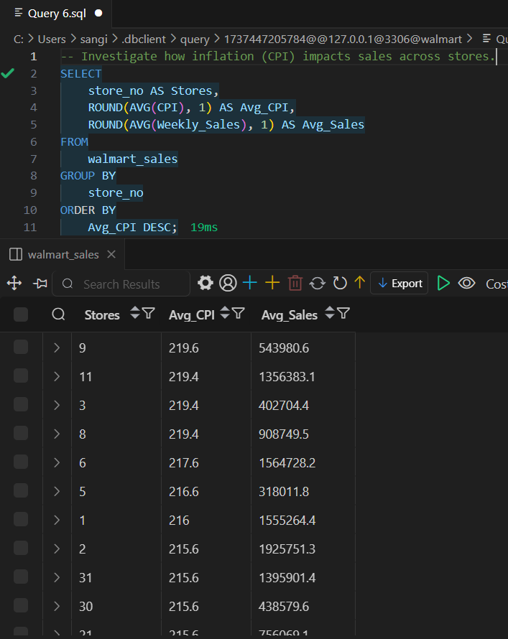
SQL Query

Slide 15
Identify stores in high-unemployment regions needing targeted promotions
This table looks at stores with their corresponding unemployment rate to decide which store needs targeted promotion.
Among the stores in regions with unemployment rates ≥ 9%, the average sales is approximately $809,636. The following stores are underperforming compared to that benchmark and may benefit from targeted promotions:
Store_ID | Unemployment Rate (%) | Average Sales
38 | 13.1 | $385,732
43 | 9.9 | $633,325
29 | 9.8 | $539,451
Store | Unemployment_Rate | Average Sales
12 | 13.1 | $ 1,009,002.0
28 | 13.1 | $ 1,323,522.0
38 | 13.1 | $ 385,732.0
34 | 9.9 | $ 966,782.0
43 | 9.9 | $ 633,325.0
29 | 9.8 | $ 539,451.0
18 | 8.8 | $ 1,084,718.0
35 | 8.8 | $ 919,725.0
7 | 8.6 | $ 570,617.0
14 | 8.6 | $ 2,020,978.0
32 | 8.6 | $ 1,166,568.0
45 | 8.6 | $ 785,981.0
33 | 8.5 | $ 259,862.0
10 | 8.4 | $ 1,899,425.0
24 | 8.4 | $ 1,356,755.0
42 | 8.4 | $ 556,404.0
22 | 8.1 | $ 1,028,501.0
The following suggestion I can recommend to improve performance of these underperforming store above are:
Localized marketing campaigns targeting essential goods or price-sensitive customers.
Community engagement initiatives to boost foot traffic.
Promotions or discounts tailored to economic conditions in those regions.

Slide 16
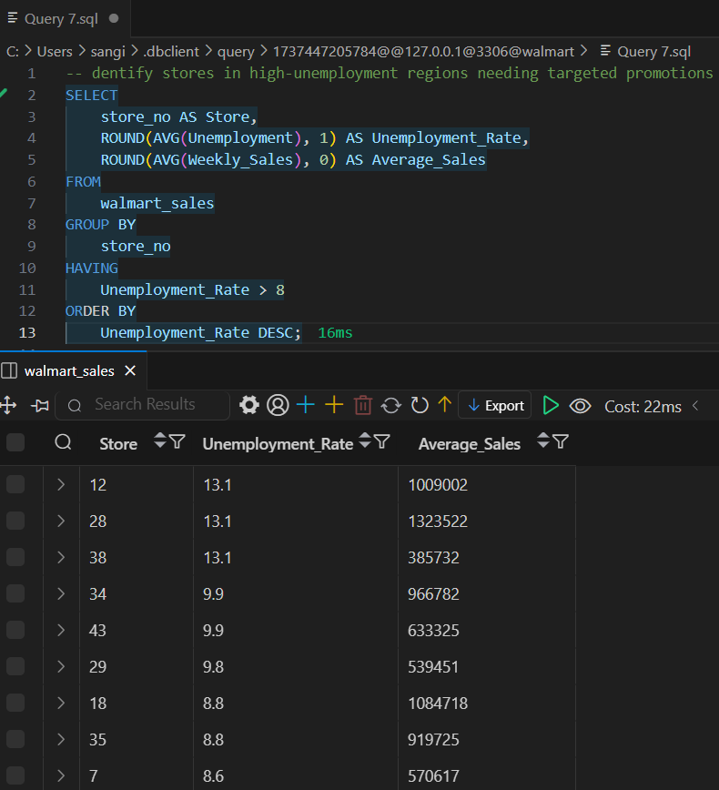
SQL Query

Slide 17
Calculate YoY growth rates for each store to prioritize investments.
Store | 2011 Growth | 2012 Decline | 2012 Sales | Insights & Notes
7 | +20% | -17% | $25.4M | ✅ Top 2011 performer — needs support to stabilize in 2012
4 | +16% | -16% | $92.8M | ✅ Strong sales in both years — potential for long-term gain
17 | +13% | -13% | $40.3M | ✅ Solid 2011, manageable dip — worth continued investment
14 | +1% | -27% | $77.4M | ⚠️ Sharp drop in 2012 — investigate root cause
15 | +1% | -23% | $24.8M | ⚠️ Low upside — deprioritize unless strategic location
21 | +7% | -25% | $29.5M | ⚠️ Significant volatility — possible restructuring needed

Slide 18
Calculate YoY growth rates for each store to prioritize investments (insights and recommendation).
Key Highlights
✅ Top Performers in 2011:
Store 7: +20%
Store 4: +16%
Store 17: +13%
Strong growth suggests effective local campaigns or market expansion.
⚠️ Biggest Declines in 2012:
Store 14: -27%
Store 15: -23%
Store 21: -25%
Indicates potential regional or operational challenges.
Year-over-Year (YoY) Growth Snapshot:
2011 saw growth across the board:
All 28 stores recorded increased sales vs. 2010
Average YoY Growth (2011): +8.4%
2012 showed a significant downturn:
All 28 stores experienced a decline compared to 2011
Average YoY Growth (2012): -17.6%
Insights for the Marketing Team
2011 Success Factors:
Marketing efforts and promotions in 2011 may have played a key role in boosting sales.
Opportunity to replicate high-performing strategies in underperforming areas.
2012 Downturn:
A systemic drop across all stores suggests broader factors (e.g., economic, supply chain, or competitor impact).
Recommend a store-by-store deep dive to identify root causes.
Segmentation Opportunity:
Group stores by performance tiers to tailor marketing strategies accordingly.
Stores with consistent growth potential should receive priority for promotional investment.

Slide 19
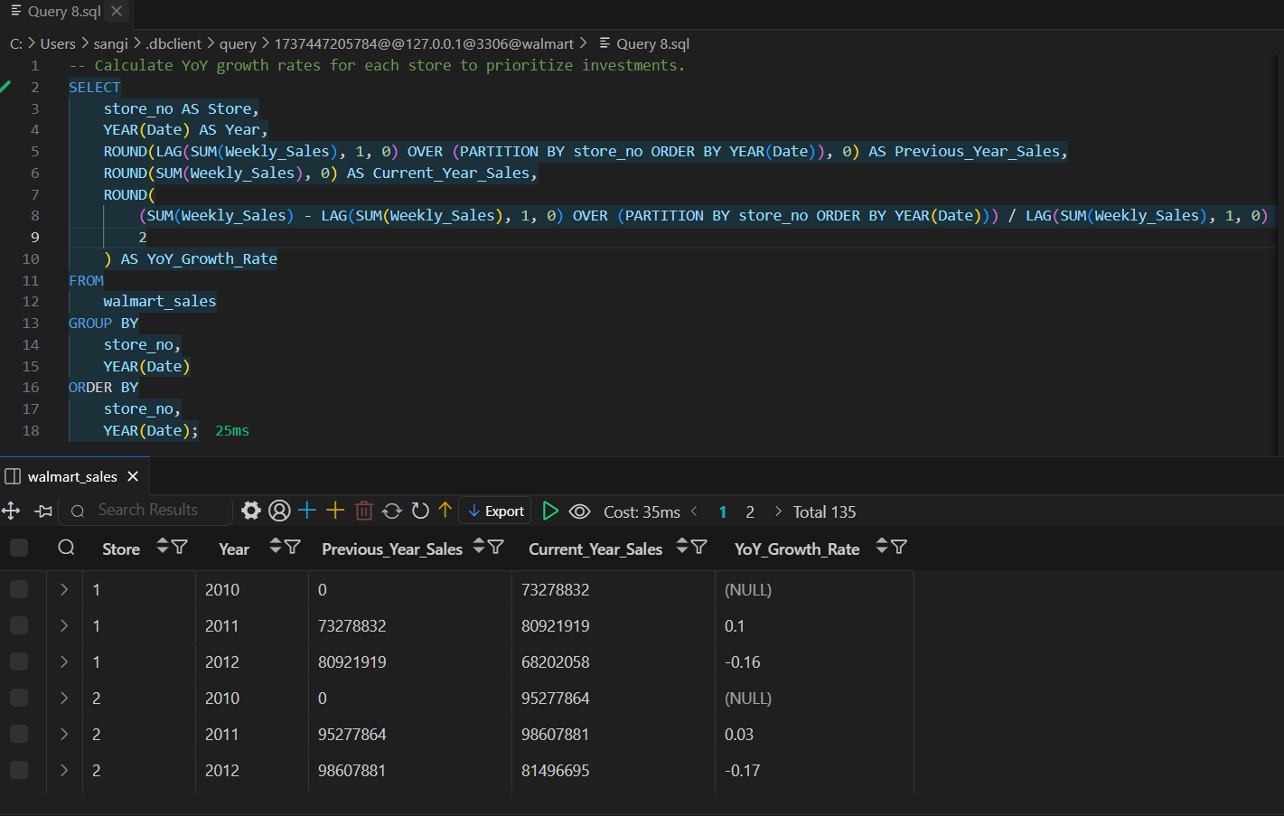
SQL Query

Slide 20
Flag stores with both high CPI and high unemployment for urgent action.
Key Observations
Store 43 faces the most challenging economic environment:
Highest CPI at 207.7
Highest unemployment at 9.9%
This may suppress consumer spending and require strategic pricing or promotions.
Stores 7 & 32 share identical CPI and unemployment rates:
CPI: 193.7
Unemployment: 8.6%
Suggests similar regional economic conditions—potential for shared strategy deployment.
Store 14 & 45 also align closely in metrics:
CPI: 186.3
Unemployment: 8.6%
Strategic Implications
Price Sensitivity Likely Higher
Customers in these regions are likely more price-conscious.
Consider value-focused promotions, bundle offers, and localized discounts.
Localized Campaigning
Marketing should highlight savings, affordability, and essential goods.
Messaging around “More for Less” may resonate well.
Community Engagement
Community programs, hiring initiatives, and CSR visibility could boost brand loyalty in high-unemployment areas.
Inventory Optimization
Focus on high-utility, lower-cost items and essential categories.
Limit luxury or discretionary items in these regions.
Store | Avg. CPI | Avg. Unemployment Rate (%)
43 | 207.7 | 9.9 (Highest)
7 | 193.7 | 8.6
32 | 193.7 | 8.6
14 | 186.3 | 8.6
45 | 186.3 | 8.6

Slide 21
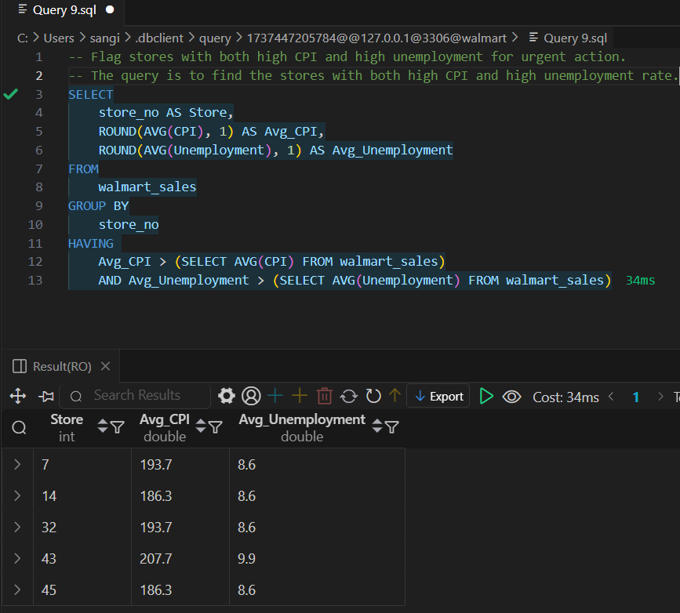
SQL Query

Slide 22
Identify seasonal buying patterns (e.g., summer vs. winter).
Key Insights
Q4 is the strongest sales quarter:
Highest average at $1.13M.
~12.2% higher than Q1.
Likely influenced by holiday shopping, Black Friday, and year-end promotions.
Stable mid-year performance (Q2 & Q3):
Moderate gains in Q2 (+3.4% from Q1), slight dip in Q3.
Indicates consistent consumer behavior mid-year with minor fluctuations.
Q1 is the weakest quarter:
Post-holiday dip, lower discretionary spending typical of Q1.
Sales recovery begins in Q2.
Strategic Implications
Q4 is the Prime Time:
Allocate heaviest marketing budget to Q4.
Launch flagship campaigns, holiday bundles, and limited-time offers.
Ensure inventory is optimized for high-demand SKUs.
Post-Holiday Drop in Q1
Use customer retention campaigns, loyalty rewards, and early-year promotions to minimize sales drop.
Consider clearance and essential-focused messaging.
Q2 & Q3 Are Opportunity Zones
Great for testing new product launches and building up for Q4.
Evaluate potential for seasonal promotions (e.g. back-to-school, summer sales).
Quarter | Average Sales (USD)
Q1 | 1,006,136
Q2 | 1,040,806
Q3 | 1,023,251
Q4 | 1,128,774 🏆

Slide 23
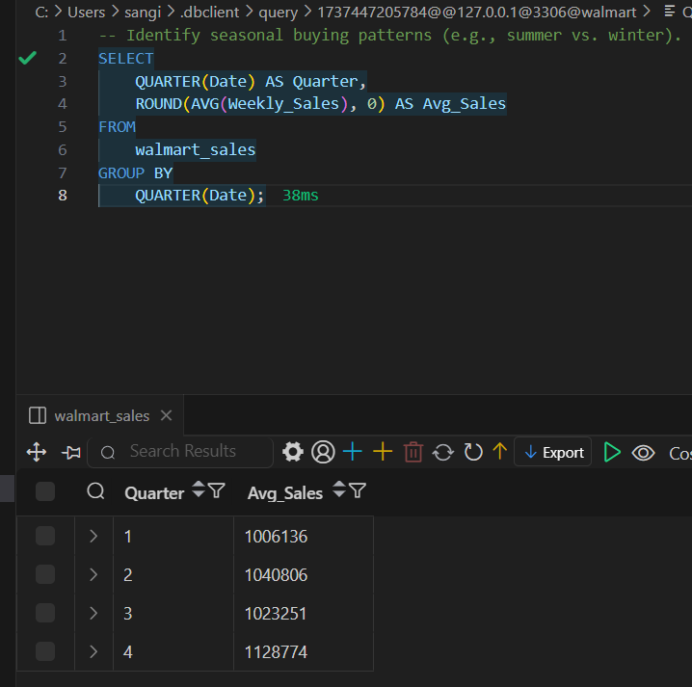
SQL Query

